Slide 1

ACFM 2025
Flow Analysis of Twin Supersonic Impinging Jets Using IDDES With Adaptive Mesh Refinement and Flow
Prediction By Operator Learning Approach
Chanho Park¹, Woochan Lee, Seongim Choi¹
Gwangju Institute of Science and Technology(GIST) ¹
Notes:
Hello, everyone. My name is Chanho Park from GIST.
Today, I will present our work on the 'Flow Analysis of Twin Supersonic Impinging Jets Using IDDES with Adaptive Mesh Refinement, and Flow Prediction by an Operator Learning Approach.

Slide 2

Contents
01
Introduction
- Motivation & Background
- Research Objectives
Part 2: AI-Based Flow Prediction
Methodology
- High-Fidelity Data Interpolation
Fourier Neural Operator (FNO)
Prediction Results & Discussion
03
02
Part 1: High-Fidelity Flow Analysis
Methodology
- Hybrid RANS - LES Model
Adaptive Mesh Refinement (AMR)
Modeling of fan - jet interaction
CFD Analysis & Results
Numerical Setup & Validation
- Unsteady Vortical Structures
04
Conclusion
Conclusion & future works
Notes:
This is the outline of my presentation today.
First, I will start with the Introduction, covering the motivation and objectives of this research.
The presentation is then divided into two main parts.
Part One will focus on our High-Fidelity Flow Analysis.
I will explain the methodology, including our hybrid RANS-LES model and adaptive “and dynamic” mesh refinement, and then present the CFD analysis and key results, including validation and the characteristics of the unsteady vortical structures.
Next, Part Two will cover our AI-Based Flow Prediction. I will describe the methodology for data interpolation and the Fourier Neural Operator model.
This will be followed by a discussion of the prediction results.
Finally, I will conclude with a summary of our findings and discuss our plans for future work.

Slide 3
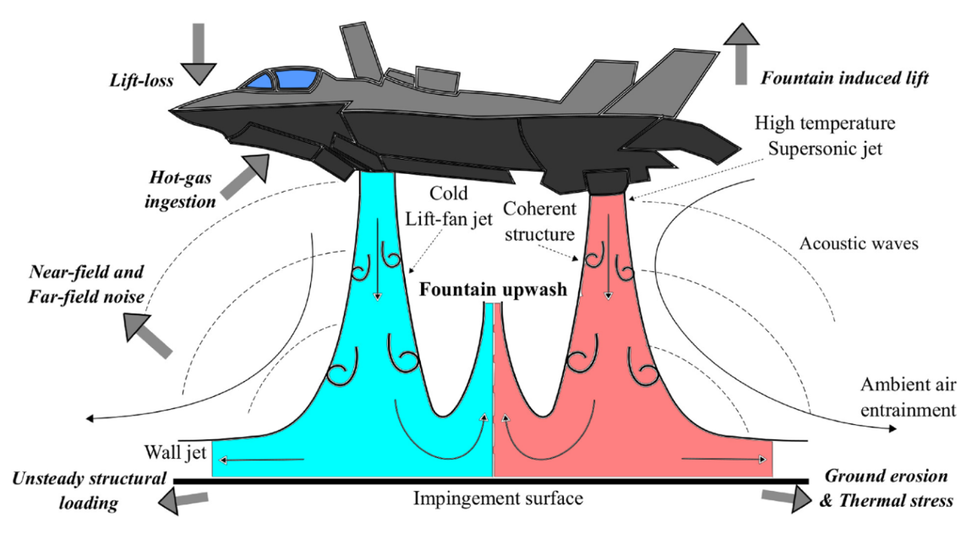
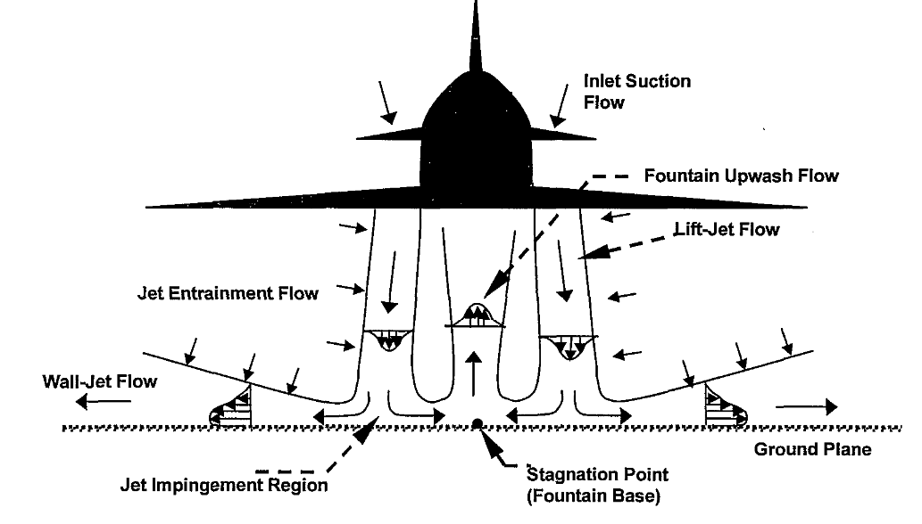
Introduction
Motivation & Background
Source : Vikas N. Bhargav et al.
Source : D.H. Hickey & R.A. De Savigney
<Schematic of the flowfield associated with dual impinging jets>
<Schematic of the flow induced by a twin jet STOVL aircraft in hover>
Aircraft like the F-35B, which can perform vertical takeoffs and landings, are capable of executing missions under various conditions, including in locations without runways, by utilizing fan and jet flows.
Such jet impingement can lead to several issues, including ground erosion, thermal stress, structural fatigue, noise, reduced engine efficiency, and loss of aerodynamic lift under certain operational conditions.
Ground vortex formation can affect the inlet airflow, potentially causing compressor surge, which poses a safety risk to the aircraft.
Notes:
As you know, Vertical takeoff and landing aircraft like the F-35B present complex aerodynamic challenges due to jet impingement, including ground erosion, structural loading, and acoustic issues.
The flow field is highly unsteady, involving shock waves and turbulent vortices, which are difficult to model.

Slide 4
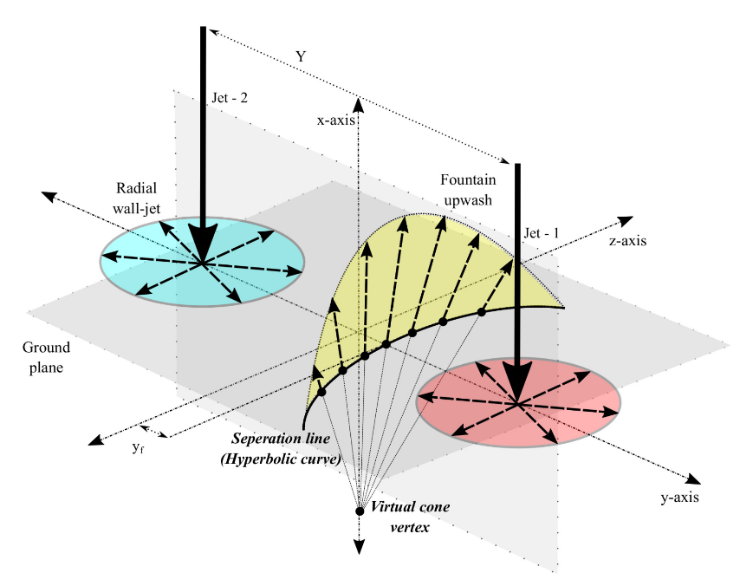
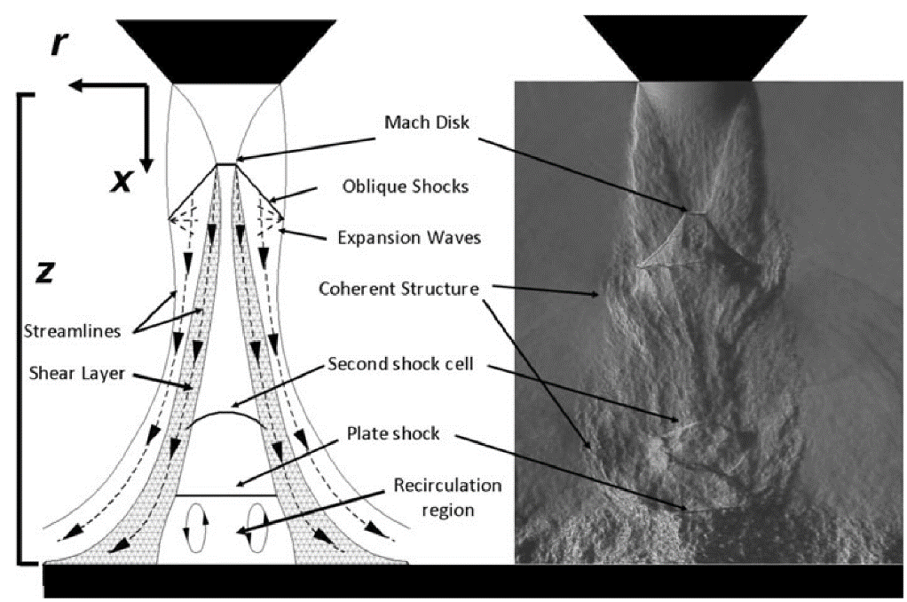
Introduction
Motivation & Background
Source : Vikas N. Bhargav et al.
Source : Daniel M. Mitchell et al.
<Schematic of dual impinging jets, showing streamlines in the wall jets, interaction region, and fountain flow region>
<A schematic of supersonic flow for an impinging underexpanded jet>
The interaction between the fan and jet flow generates complex vortices and turbulence, which is challenging to model.
High-fidelity CFD (e.g., IDDES with AMR) is required to accurately capture these unsteady phenomena
These simulations are computationally expensive, creating a need for efficient flow prediction models
Notes:
To accurately capture the characteristics of the flows, high-fidelity CFD, like the IDDES with dynamic AMR is essential.
However, these simulations are computationally intensive and time-consuming.
This trade-off between accuracy and computational cost is the primary motivation for our work, highlighting the need for an efficient model that can rapidly predict these complex flow fields.

Slide 5
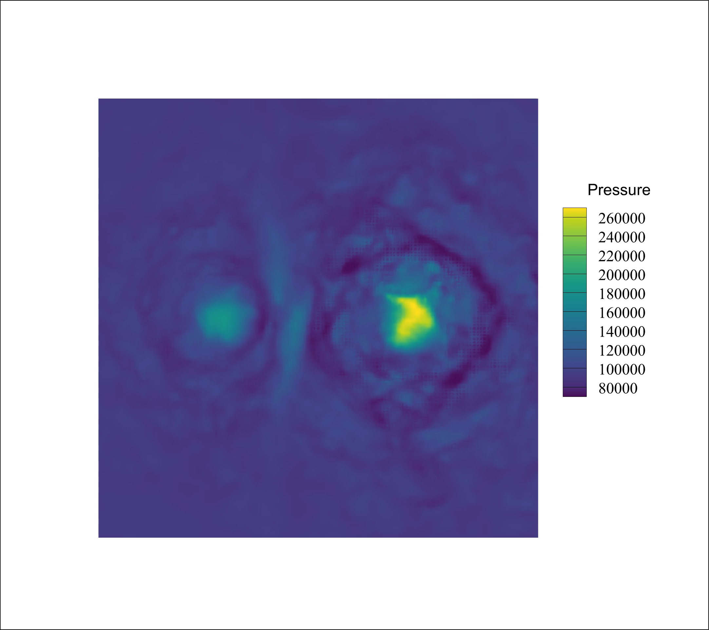
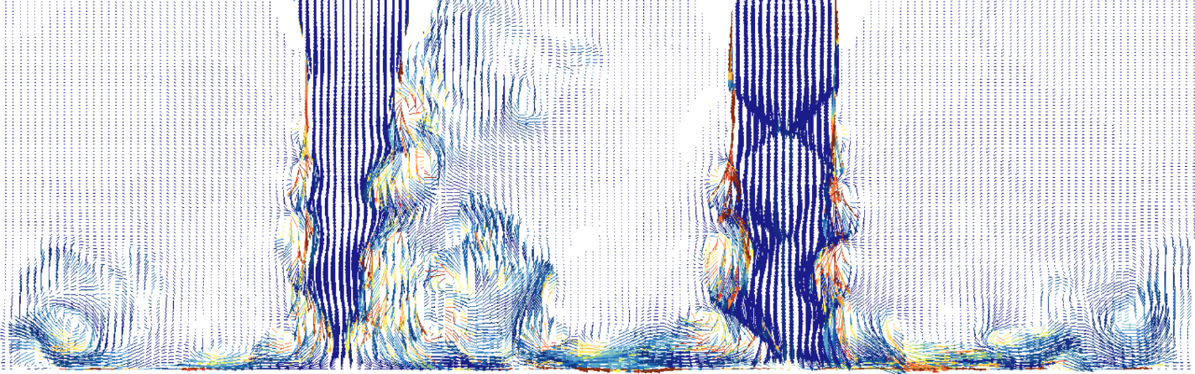
Introduction
What We Do?
Our results
< Velocity streamlines colored by vorticity magnitude of impinging twin jet>
<Predicted pressure contour>
Conduct high-fidelity analysis of unsteady twin-jet ground effect.
* Using a hybrid RANS-LES (IDDES) model with Adaptive Mesh Refinement (AMR)
(2) Develop a rapid flow prediction model for the ground effect.
* Using a Fourier Neural Operator (FNO) trained on the high-fidelity CFD data.
Notes:
Therefore, % Our research has two primary objectives.
First, to conduct a high-fidelity analysis of the twin-jet ground effect using advanced scale-resolving simulations and adaptive mesh refinement.
Second, to leverage this high-fidelity data to develop a rapid and accurate flow prediction model using a Fourier Neural Operator.
This is motivated by the fact that Computationl cost for the DES is a few days, and the FNO prediction is less than a minute.

Slide 6
Contents
01
Introduction
- Motivation & Background
- Research Objectives
Part 2: AI-Based Flow Prediction
Methodology
- High-Fidelity Data Interpolation
Fourier Neural Operator (FNO)
Prediction Results & Discussion
03
02
Part 1: High-Fidelity Flow Analysis
Methodology
- Hybrid RANS - LES Model
Adaptive Mesh Refinement (AMR)
Modeling of fan - jet interaction
CFD Analysis & Results
Numerical Setup & Validation
- Unsteady Vortical Structures
04
Conclusion
Conclusion & future works
Notes:
Now, I will move on to the first part of my talk: the high-fidelity flow analysis.

Slide 7
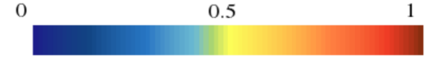
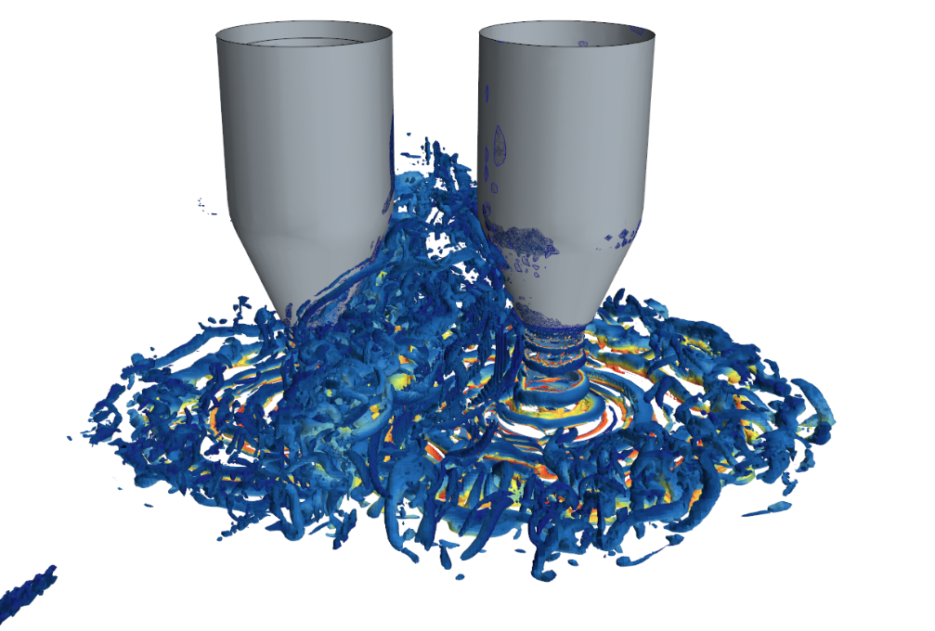
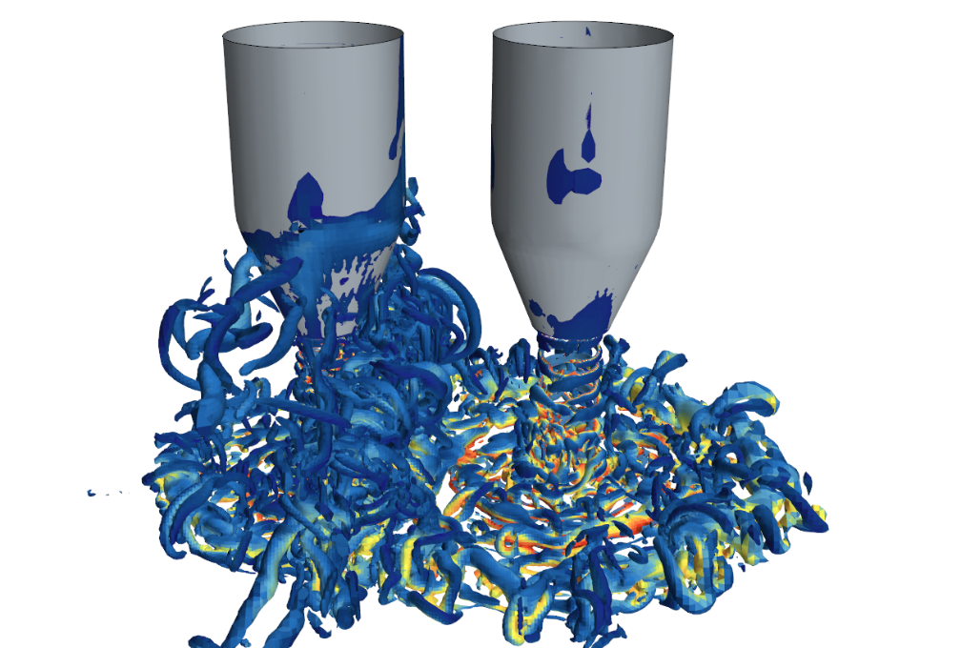
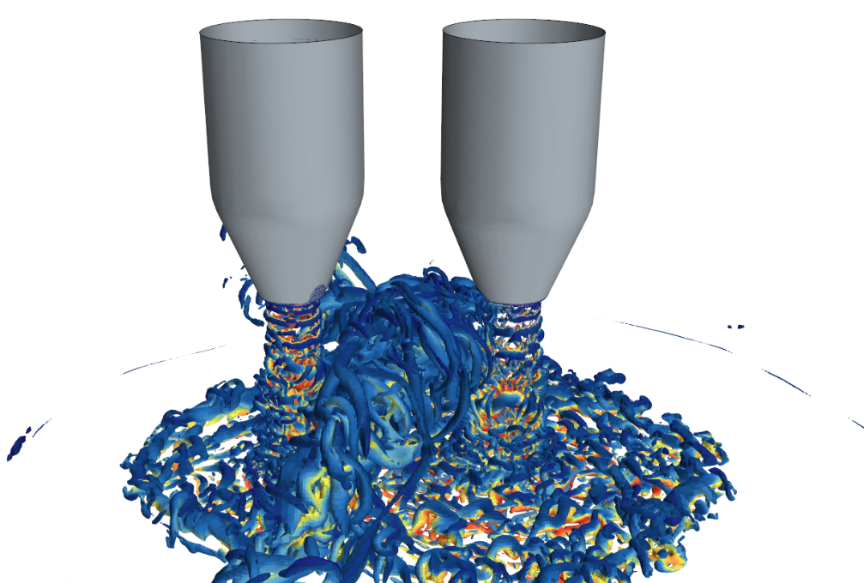
Introduction
What we have done
Fountain upwash
<Q-criterion = 1E8>
< Instantaneous Q-criterion iso-surface>
Converging nozzle
C-D nozzle
<Schematic of dual impinging jets, showing streamlines in the wall jets, interaction region, and fountain flow region>
<H = 2D>
<H = 3.25D>
<H = 4D>
The impact, fountain upwash, and re-entrainment mechanisms change systematically with ground clearance
identified periods in which the flow becomes increasingly unsteady over time.
Notes:
Our current work builds upon our previous analysis, where we studied the effect of ground clearance
As shown here, we identified that key flow structures, such as the fountain upwash, change systematically with height, leading to periods of increasing unsteadiness.

Slide 8
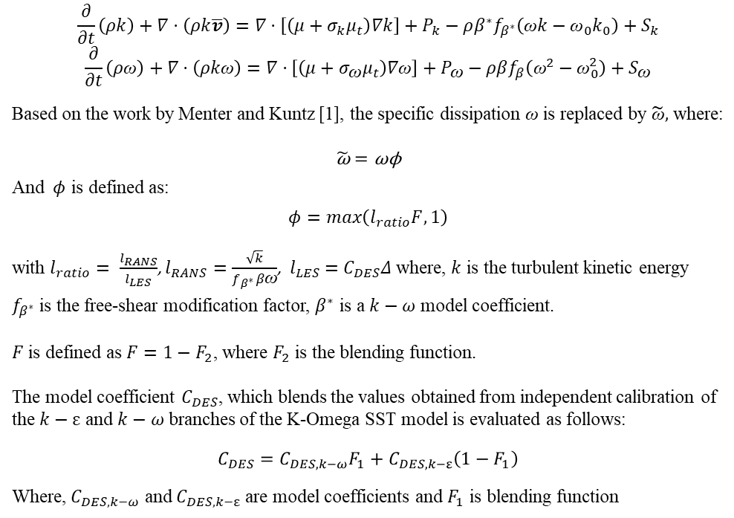
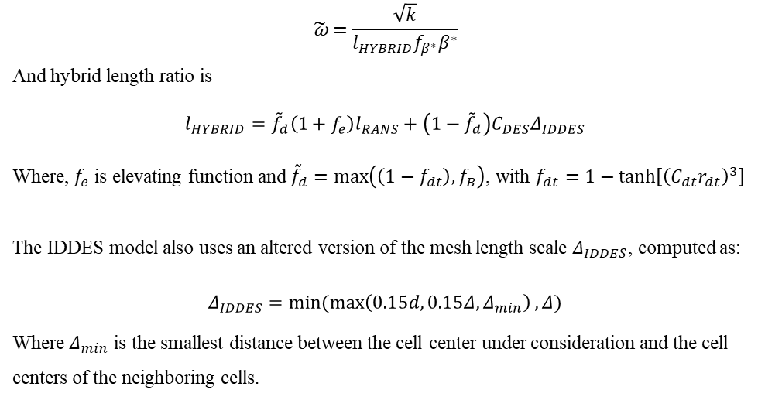
Part1: Methodology
Hybrid RANS-LES Model
DDES (Delayed Detached Eddy Simulation)
IDDES(Improved Delayed Detached Eddy Simulation)
The transport equations for the kinetic energy $k$ and the specific dissipation rate ω are:
For the IDDES formulation of Shur et al. [2], the specific dissipation rate ω in transport equation is replaced by $\tilde{\text{ω}}$ defined as:
$$\frac{∂}{∂t}\left(ρk\right)+∇·\left(ρk\overline{v}\right)=∇·\left[\left(μ+σ_{k}μ_{t}\right)∇k\right]+P_{k}−ρβ^{∗}f_{β^{∗}}\left(\text{ω}k−{\text{ω}}_{0}k_{0}\right)+S_{k}$$
$$\frac{∂}{∂t}\left(ρ\text{ω}\right)+∇·\left(ρk\text{ω}\right)=∇·\left[\left(μ+σ_{\text{ω}}μ_{t}\right)∇\text{ω}\right]+P_{\text{ω}}−ρβf_{β}\left({\text{ω}}^{2}−{\text{ω}}_{0}^{2}\right)+S_{\text{ω}}$$
Based on the work by Menter and Kuntz [1], the specific dissipation $\text{ω}$ is replaced by $\tilde{\text{ω}},$ where:
$$\tilde{\text{ω}}=\text{ω}\text{ϕ}$$
And $φ$ is defined as:
$$φ=max\left(l_{ratio}F, 1\right)$$
with $l_{ratio}= \frac{l_{RANS}}{l_{LES}}$, $l_{RANS}=\frac{\sqrt{k}}{f_{β^{∗}}β\text{ω}}$, ${ l}_{LES} =C_{DES}Δ$ where, $k$ is the turbulent kinetic energy
$f_{β^{∗}}$ is the free-shear modification factor, $β^{∗}$ is a $k−ω$ model coefficient.
$F$ is defined as $F=1−F_{2}$, where $F_{2}$ is the blending function.
The model coefficient $C_{DES}$, which blends the values obtained from independent calibration of the $k−ε$ and $k−ω$ branches of the K-Omega SST model is evaluated as follows:
$$C_{DES}=C_{DES,k−ω}F_{1}+C_{DES,k−ε}\left(1−F_{1}\right)$$
Where, $C_{DES,k−ω}$ and $C_{DES,k−ε}$ are model coefficients and $F_{1}$ is blending function
$$\tilde{\text{ω}}=\frac{\sqrt{k}}{{l_{HYBRID}f}_{β^{∗}}β^{∗}}$$
And hybrid length ratio is
$$l_{HYBRID}={\tilde{f}}_{d}\left(1+f_{e}\right)l_{RANS}+\left(1−{\tilde{f}}_{d}\right)C_{DES}Δ_{IDDES}$$
Where, $f_{e}$ is elevating function and ${\tilde{f}}_{d}=\max\left(\left(1−f_{dt}\right),f_{B}\right)$, with $f_{dt}=1−\tanh\left[{\left(C_{dt}r_{dt}\right)}^{3}\right]$
The IDDES model also uses an altered version of the mesh length scale $Δ_{IDDES}$, computed as:
$$Δ_{IDDES}=min⁡(\max\left(0.15d, 0.15Δ,Δ_{min}\right),Δ)$$
Where $Δ_{min}$ is the smallest distance between the cell center under consideration and the cell centers of the neighboring cells.
[1] Menter, F. R. and Kuntz, M. 2002. “Adaptation of Eddy Viscosity Turbulence Models to Unsteady Separated Flows Behind Vehicles”, in The Aerodynamics of Heavy Vehicles: Trucks, Buses and Trains, Springer, Asilomar, CA.
[2] Shur, M.L., Spalart, P.R., Strelets, M.Kh., and Travin, A.K. 2008. “A hybrid RANS-LES approach with delayed-DES and wall-modelled LES capabilities”, International Journal of Heat and Fluid Flow, 29(6), pp. 1638-1649.
8
Notes:
For our high-fidelity analysis, we used the IDDES model, a hybrid RANS-LES approach that efficiently balances accuracy and cost.
We expect that this advanced simulation technique will allow us to accurately capture the complex, unsteady flow physics of the jet interaction.

Slide 9
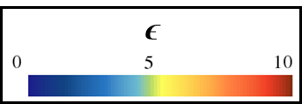
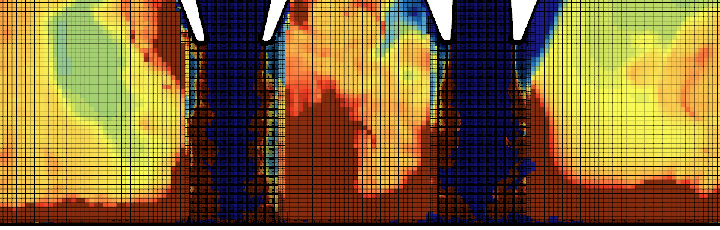
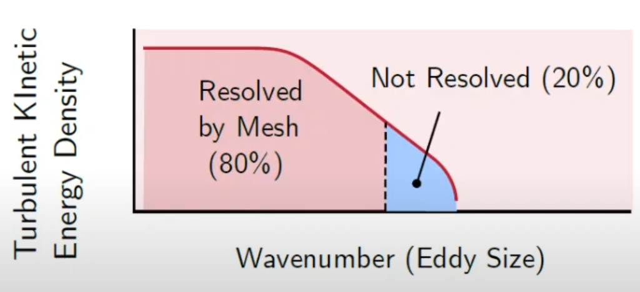
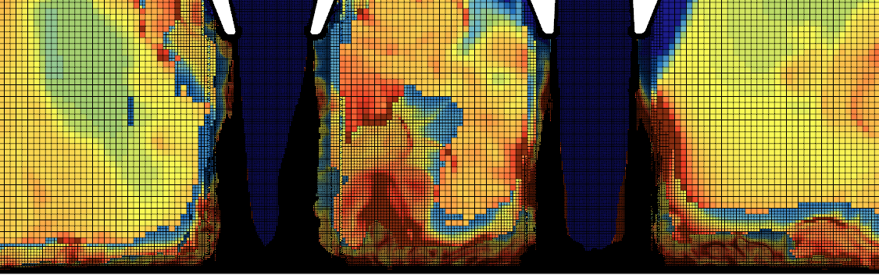
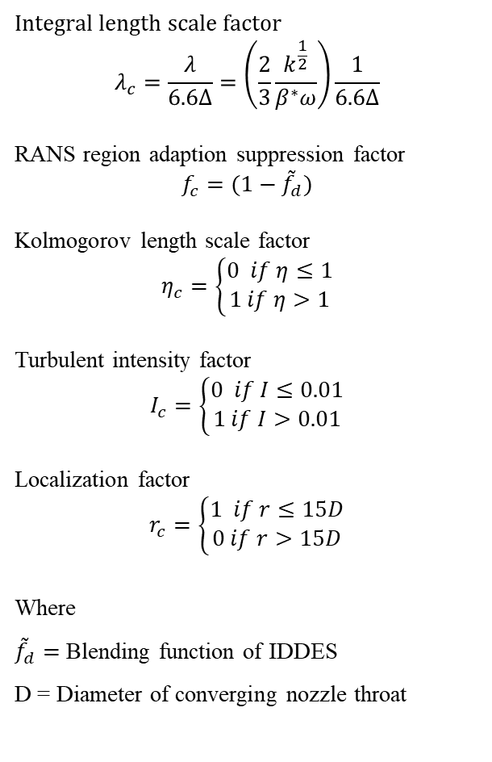
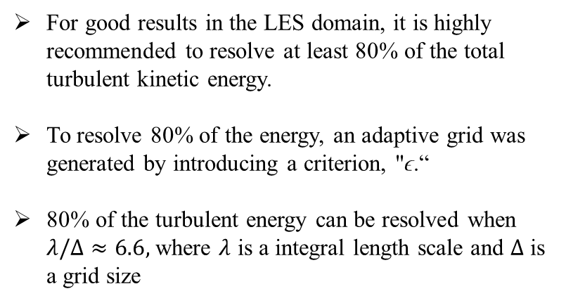
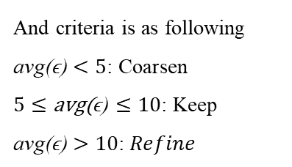
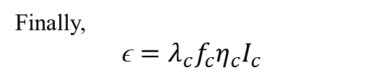
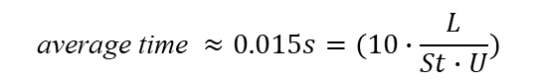
Part1: Methodology
Adaptive mesh refinement criteria
$$\text{average} \text{time} ≈0.015s=(10∙\frac{L}{St∙U})$$
Integral length scale factor
$$λ_{c}=\frac{λ}{6.6Δ}=\left(\frac{2}{3}\frac{k^{\frac{1}{2}}}{β^{∗}ω}\right)\frac{1}{6.6Δ}$$
RANS region adaption suppression factor
$$f_{c}=(1−{\tilde{f}}_{d})$$
Kolmogorov length scale factor
$$η_{c}=\left\{\begin{aligned}0 if η≤1 \\ 1 if η>1\end{aligned}\right.$$
Turbulent intensity factor
$$I_{c}=\left\{\begin{aligned}0 if I≤0.01 \\ 1 if I>0.01\end{aligned}\right.$$
Localization factor
$$r_{c}=\left\{\begin{aligned}1 if r≤15D \\ 0 if r>15D\end{aligned}\right.$$
Where
${\tilde{f}}_{d}=$ Blending function of IDDES
D = Diameter of converging nozzle throat
For good results in the LES domain, it is highly recommended to resolve at least 80% of the total turbulent kinetic energy.
To resolve 80% of the energy, an adaptive grid was generated by introducing a criterion, "ϵ.“
80% of the turbulent energy can be resolved when $λ/Δ≈6.6,$ where $λ$ is a integral length scale and $Δ$ is a grid size
Finally,
$$\text{ϵ}=λ_{c}f_{c}η_{c}I_{c}$$
And criteria is as following
$$\text{avg}\text{(}\text{ϵ}\text{)}<\text{5}\text{: }\text{Coarsen}$$
$$5≤\text{avg}\text{(}\text{ϵ}\text{)}≤\text{10}\text{: }\text{Keep}$$
$$\text{avg}\text{(}\text{ϵ}\text{)}>\text{10}\text{: }Refine$$
Source : Aidan Wimshurst
<Unrefined>
<Refined>
Notes:
To enhance resolution in critical areas like the shear layers, we applied Adaptive Mesh Refinement, aiming to resolve at least 80% of the turbulent kinetic energy.
For this, we developed a composite criterion called epsilon (ϵ), which combines several flow factors—such as the integral length scale, the IDDES blending function, and turbulent intensity.
This criterion dynamically identifies regions that require refinement, allowing us to efficiently focus our computational resources.

Slide 10
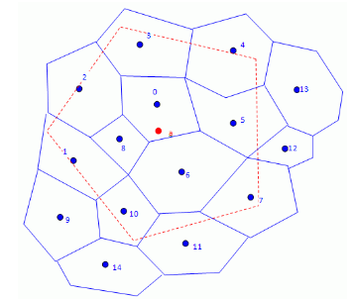
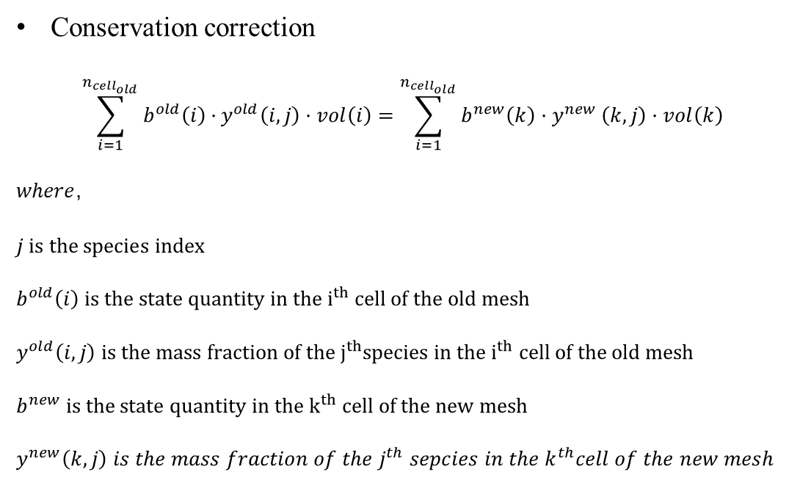
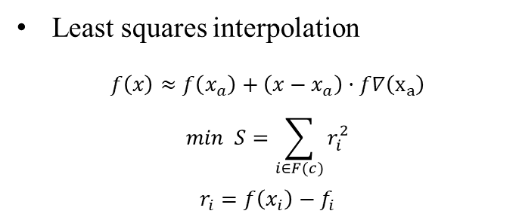
Part1: Methodology
Interpolation for adaptive mesh refinement
Conservation correction
$$\sum_{i=1}^{n_{cell_{old}}}{b^{old}\left(i\right)·}y^{old}\left(i,j\right)·vol\left(i\right)=\sum_{i=1}^{n_{cell_{old}}}{b^{new}\left(k\right)·y^{new}}\left(k,j\right)·vol\left(k\right)$$
$where$,
$$j is the species index$$
$$b^{old}\left(i\right) is the state quantity in the i^{th} cell of the old mesh$$
$$y^{old}\left(i,j\right) is the mass fraction of the j^{th}species in the i^{th} cell of the old mesh$$
$$b^{new} is the state quantity in the k^{th} cell of the new mesh$$
$$y^{new}\left(k,j\right) is the mass fraction of the j^{th} sepcies in the k^{th}cell of the new mesh$$
a
Least squares interpolation
$$f\left(x\right)≈f\left(x_{a}\right)+\left(x−x_{a}\right)·f∇\left(x_{a}\right)$$
$$min S=\sum_{i∈F(c)}{r_{i}^{2}}$$
$$r_{i}=f\left(x_{i}\right)−f_{i}$$
Notes:
We implemented the previous mesh adaptation criteria into STAR-CCM+, % but rather than using a plane mid-point subdivision, %
we applied the conservation correction % after the subdivide mesh is interpolated % using the least-squared interpolation.

Slide 11
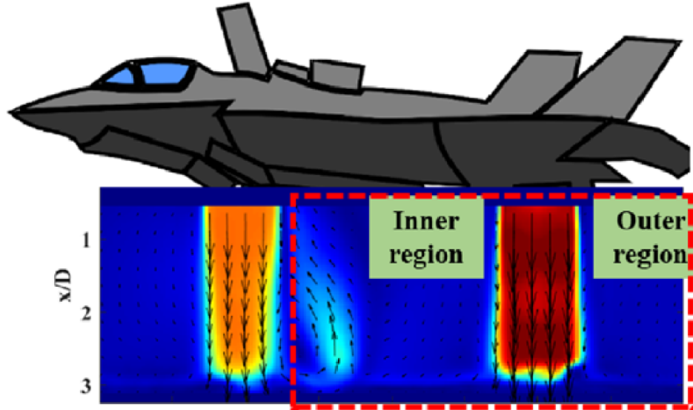
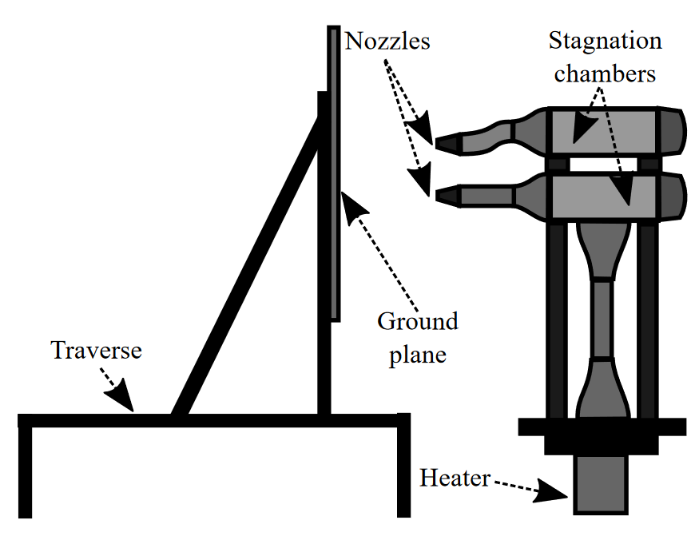
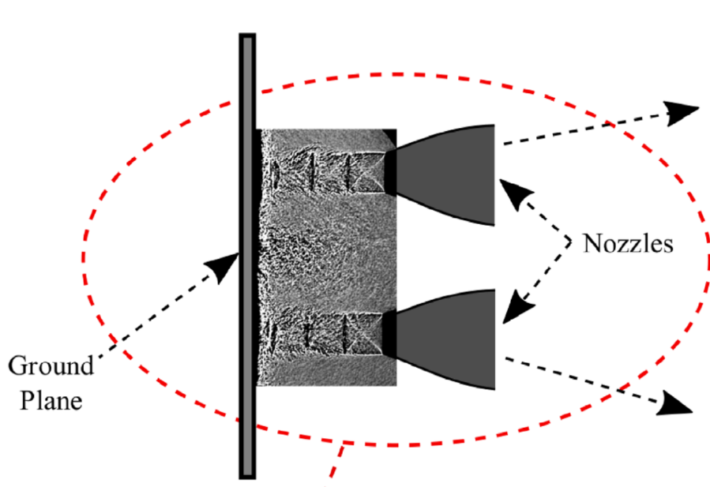
Part1: Methodology
Modeling of fan-jet flow interaction
Source : Vikas N. Bhargav et al.
The analysis is based on the approach described in paper [3], where the interaction between fan flow and jet flow under ground effect was simulated by modeling the fan flow as a nozzle jet
This method effectively captures the dynamics between the two flows near the ground.
<A schematic diagram illustrating the method for simulating the interaction between fan and jet flows>
[3] Bhargav, Vikas N., et al. "Effect of relative jet momentum in supersonic dual impinging jets." Experiments in Fluids 63.10 (2022): 163.
Notes:
To investigate the interaction between fan and jet flow under ground effect, %
we modeled the fan flow as a nozzle flow % based on Vikas's previous research.
This approach allows us to % effectively observe the complex interactions % between the two flows.

Slide 12
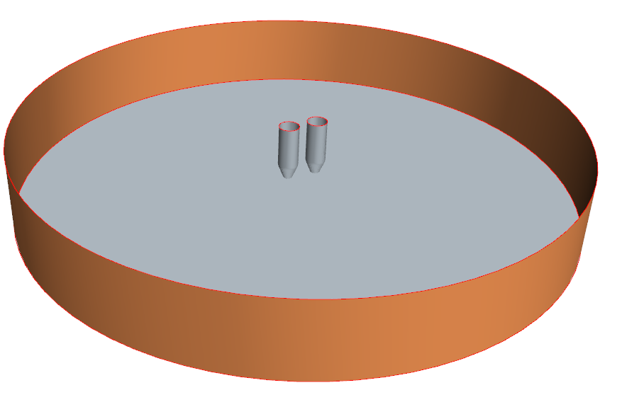
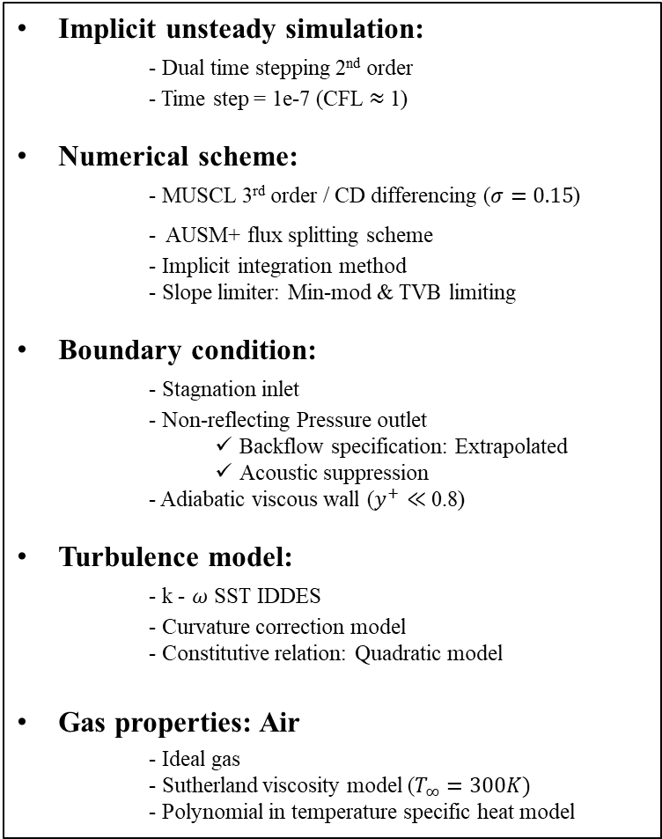
PArt1: CFD Analysis
Numerical simulation setup
Implicit unsteady simulation:
- Dual time stepping 2nd order
- Time step = 1e-7 (CFL $≈$ 1)
Numerical scheme:
- MUSCL 3rd order / CD differencing ($σ=0.15$)
- AUSM+ flux splitting scheme
- Implicit integration method
- Slope limiter: Min-mod & TVB limiting
Boundary condition:
- Stagnation inlet
- Non-reflecting Pressure outlet
Backflow specification: Extrapolated
Acoustic suppression
- Adiabatic viscous wall ($y^{+}≪$ 0.8)
Turbulence model:
- k - $ω$ SST IDDES
- Curvature correction model
- Constitutive relation: Quadratic model
Gas properties: Air
- Ideal gas
- Sutherland viscosity model ($T_{∞}=300K)$
- Polynomial in temperature specific heat model
Inlet: Stagnation inlet
Nozzle: Wall
Top face: Pressure outlet
Bottom face: Wall
Side face: Pressure outlet
<Boundary conditions of the computational domain>
Notes:
This slide details our numerical setup.
Key aspects include using a 3rd order MUSCL / Central hybrid scheme with an AUSM+ flux splitting, and an implicit unsteady solver.
We applied non-reflecting pressure outlet boundary conditions to minimize acoustic contamination.
The nozzle geometries and operating conditions are based on the experimental work of Vikas et al

Slide 13
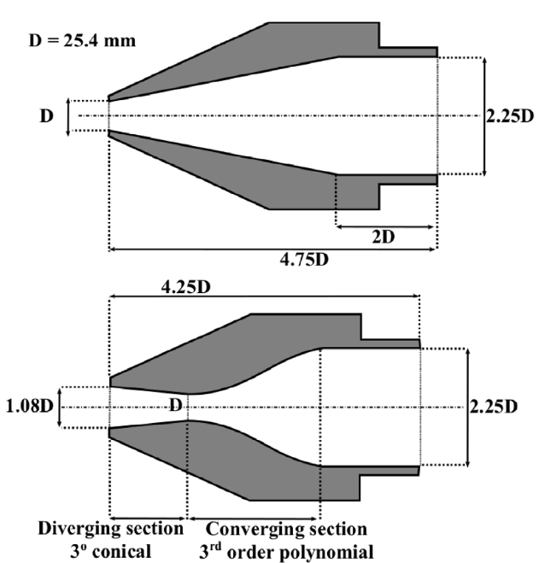
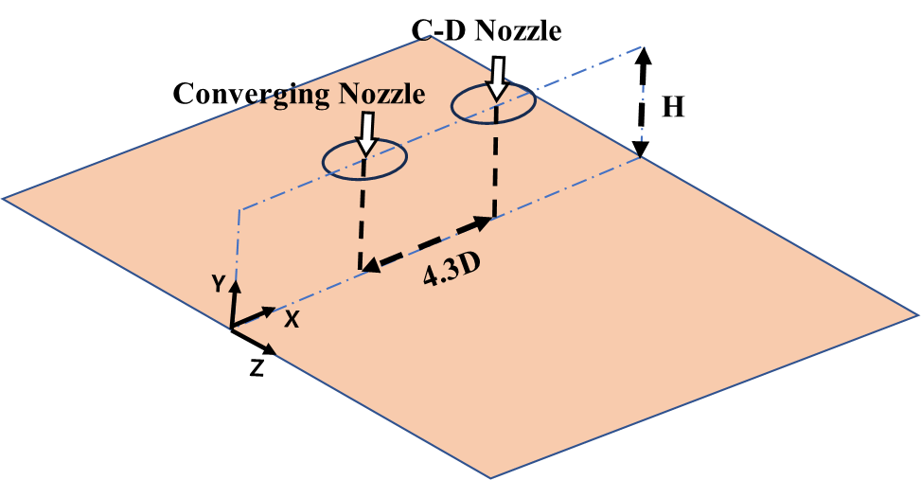
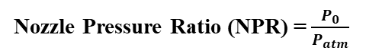
PArt1: CFD Analysis
Numerical simulation geometries & conditions
Source : Vikas N. Bhargav et al.
40D
<Nozzle geometric dimension>
11.25D
Nozzle Pressure Ratio (NPR) = $\frac{P_{0}}{P_{atm}}$
Nozzle | Converging Nozzle | C-D Nozzle
Design Mach number | 1.0 | 1.5
Nozzle Diameter | 25.4 mm (exit) | 25.4 mm (throat)
Nozzle NPR | 1.81 | 3
Nozzle axes separation | 4.3D
Impingement height (H) | 3.25D | Impingement height (H)
<Dimensions of the computational domain>
<Nozzle geometries and operating conditions>
Notes:
The geometry specifications % and domain size for the simulation are as follows:
(converging nozzle 가리키면서)
To simulate the fan and jet flows, % we used a converging nozzle to represent the fan % and a C-D nozzle for the jet flow.
The exit［엑싯］ diameter of the converging nozzle was set to D, % and the distance［디스턴스］ between the two nozzles along the axis % was set to 4.3D.
The height from the ground % was set at three and a quarter D.
The nozzle inlet NPR was set to 1.81 for the converging nozzle % and 3 for the C-D nozzle. (5분)

Slide 14
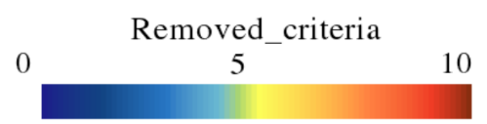
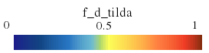
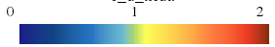
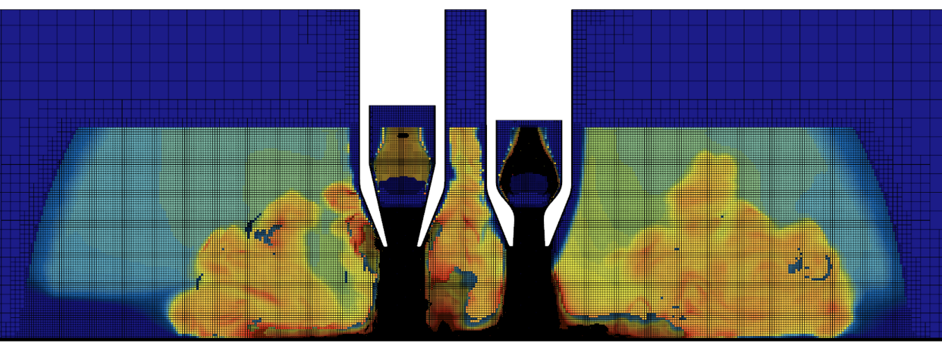
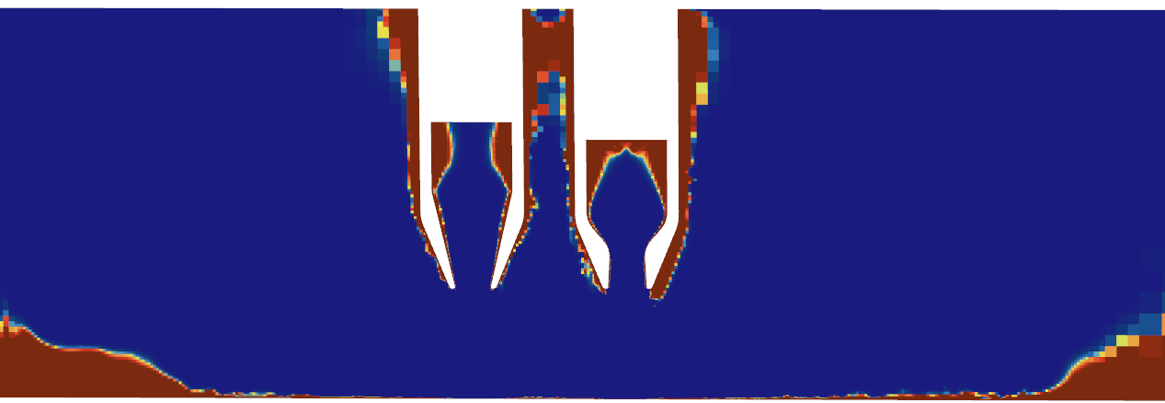
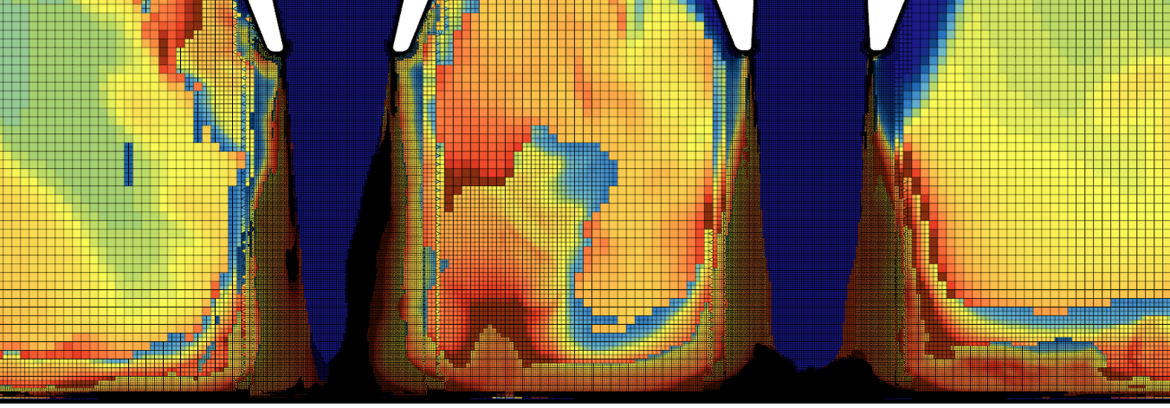
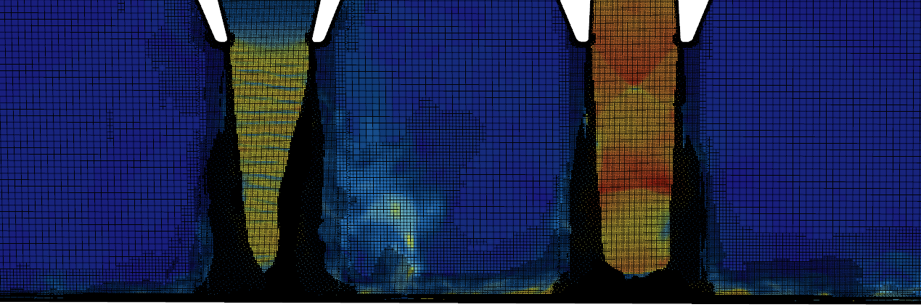

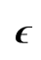

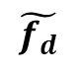


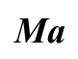
PArt1: CFD Analysis
Adaptive mesh refinement contour?)
$$\text{ϵ}$$
$$\tilde{f_{d}}$$
$$\text{Ma}$$
$$\text{ϵ}$$
$$\tilde{f_{d}}$$
$$\text{ϵ}$$
$$\text{Ma}$$
<Mach number contour with overlaid gridline>
Cell count: 47 million
Notes:
This slide shows a contour［칸투어］ plot of the mesh refinement criteria% in the flow field
As we increase the refinement level, %more subgrid kinetic energy gets resolved, % we can see that the energy is well-resolved throughout the flow field, % except in areas［애뤼어스］ with Rans region

Slide 15
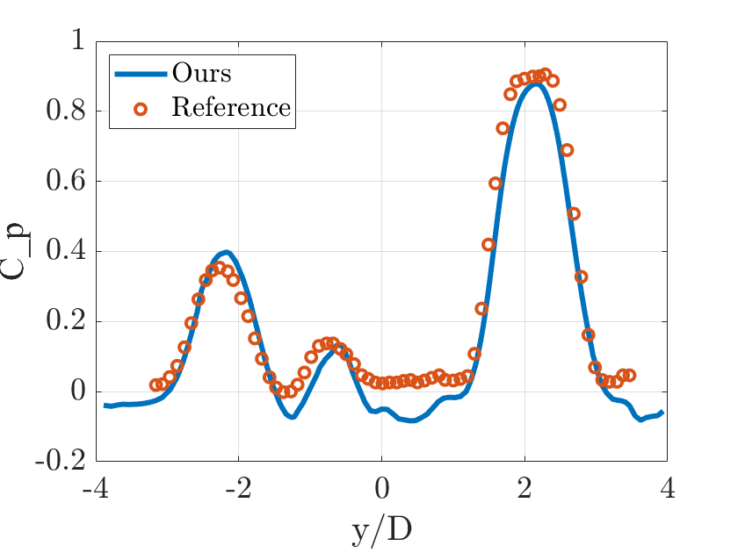
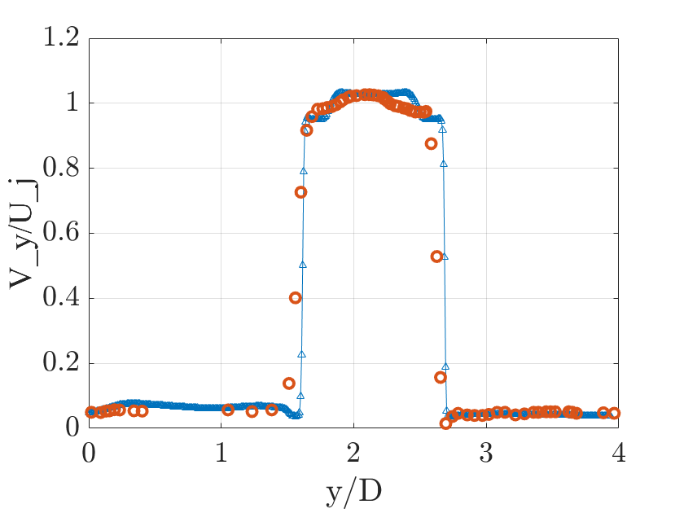
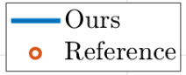
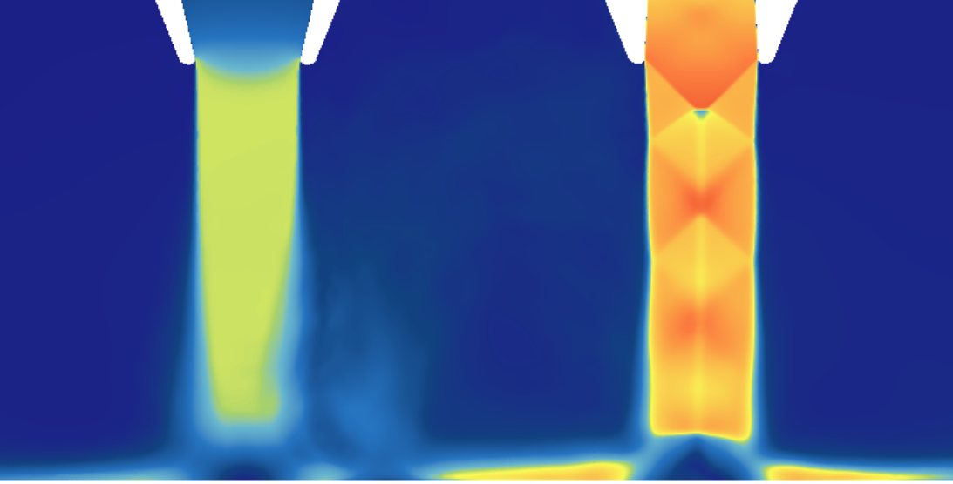
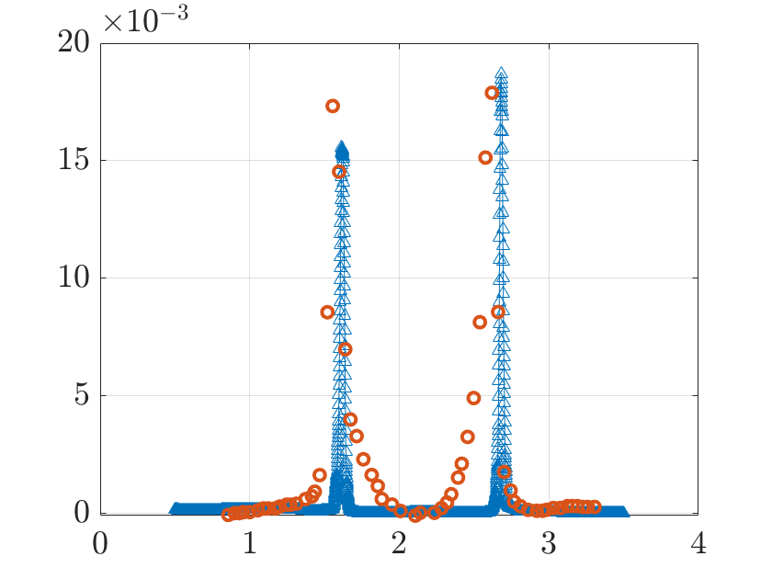
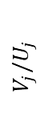
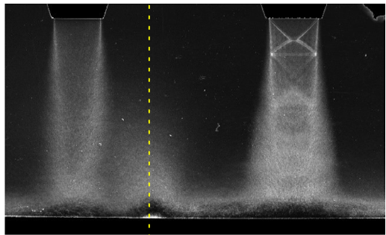
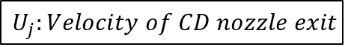




Part1: Results
Validation
$$TKE=\frac{3}{4}(\overline{u^{′2}}+\overline{v^{′2}})$$
$$C_{P}=\frac{P−P_{amb}}{P_{0, CD}−P_{amb}}$$
$$U_{j}:Velocity of CD nozzle exit$$
<H = 4D>
$$C_{p}$$
$$V_{j}/U_{j}$$
<Pressure coefficient at bottom wall>
<Velocity profile (y/D = -0.25)>
$$\left|TKE\right|/U_{j}^{2}$$
<Turbulent kinetic energy at CD nozzle (y/D = -0.6)>
<Time averaged Mach number contour vs. schlieren flow visualization>
[3] Bhargav, Vikas N., et al. "Effect of relative jet momentum in supersonic dual impinging jets." Experiments in Fluids 63.10 (2022): 163.
Notes:
Before proceeding to the main analysis, we first validated our simulation setup to ensure its reliability.
As you can see, the ground pressure coefficient profile shows excellent quantitative agreement with the experimental reference data.
Furthermore, both the mean velocity profiles and the turbulent kinetic energy peaks are also well-predicted by our simulation.

Slide 16











Part1: Results
Twin impinging jets characteristics
$$τ≈0.14 ms$$
Pressure
Fountain
Instability wave
$$\text{Ma}$$
Converging nozzle exit diameter
(a)
(b)
Plate shock
(c)
(d)
Expansion wave & Compression wave pair
<Instantaneous pressure contour (a) $t/τ$ = 0, (b) $t/τ$ = 1/3, (c) $t/τ$ = 2/3 , (d) $t/τ$ = 1 >
Notes:
Our simulations revealed highly complex and unsteady vortical structures.
A key observation is the instability wave in the converging nozzle's jet, driven by a self-sustaining feedback loop.
This feedback is amplified by the interactions within the fountain upwash region, where intricate vortex structures can significantly deflect the main flow direction of the converging nozzle.
This strong temporal evolution is precisely the kind of complex physics that is challenging to predict efficiently, which leads us to Part 2 of our study

Slide 17
Contents
01
Introduction
- Motivation & Background
- Research Objectives
Part 2: AI-Based Flow Prediction
Methodology
- High-Fidelity Data Interpolation
Fourier Neural Operator (FNO)
Prediction Results & Discussion
03
02
Part 1: High-Fidelity Flow Analysis
Methodology
- Hybrid RANS - LES Model
Adaptive Mesh Refinement (AMR)
Modeling of fan - jet interaction
CFD Analysis & Results
Numerical Setup & Validation
- Unsteady Vortical Structures
04
Conclusion
Conclusion & future works
Notes:
Here, I will explain the methodology for preparing the data and training the Fourier Neural Operator, and then I will show the prediction results.

Slide 18






Part2: Methodology
Interpolation for AI models
Source : C.Tam
System Construction:
$$A_{jk}=Φ\left(x_{j},x_{k}\right), b_{j}=Φ\left(x_{p},x_{j}\right),$$
$$\left[\begin{matrix}A & 1 \\ 1^{T} & 0\end{matrix}\right]\left[\begin{matrix}c \\ λ\end{matrix}\right]=\left[\begin{matrix}b \\ 1\end{matrix}\right]$$
The value at a target point $x_{p}$​ is a weighted sum of N surrounding stencil points $x_{j}$​.
$$f{(x}_{p})≈\sum_{i=1}^{N}{c_{j}f(x_{j})}$$
Local error:
$$E_{local}\left(k\right)={\left|e^{i\left(k_{x}x_{p}+k_{z}z_{p}\right)}−Σ_{j=1}^{N}c_{j}e^{i\left(k_{x}x_{j}−k_{z}z_{j}\right)}\right|}^{2}$$
Optimization:
$$min⁡(L)=\int{\int_{Ω_{k}}{E_{local}\left(k_{x},k_{z}\right)dk_{x}dk_{z} s.t. λ(Σ_{j=1}^{N}c_{j}−1)}}$$
DRP (Dispersion Relation Preserving) Basis Function:
$$Φ(x_{j}​,x_{k}​)=4⋅\frac{​\sin\left(κΔx_{jk}​\right)}{Δx_{jk}}​⋅\frac{​\sin\left(κΔz_{jk}​\right)}{Δz_{jk}}​$$
Interpolation method |  | C. Tam’s (DRP) | IDW (Inverse Distance Weighted) | Linear
$$R^{2}$$ | Density | 0.920 | 0.919 | 0.744
 | Pressure | 0.905 | 0.905 | 0.758
<Evaluated at the bottom wall>
Where,
$$R^{2}=1−\frac{Σ_{i∈I}{\left(y_{i}−\hat{y_{i}}\right)}^{2}}{Σ_{i∈I}{\left(y_{i}−\overline{y}\right)}^{2}},$$
$$\overline{y}=\frac{1}{|I|}Σ_{i∈I}y_{i}$$
With setting $κ=1, N=7$
Notes:
A critical step is to transfer our solution data on irregular mesh to a uniform grid for the FNO.
To preserve the data's integrity, we used Chris. Tam's DRP-based interpolation, which is optimized in the wavenumber domain and is significantly more accurate than linear methods for wave-like phenomena.

Slide 19




Part2: Methodology
Fourier Neural Operator
Auto regressive mechanism
$$𝒢_{θ}:f\left(q\right)↦u(q)$$
$$q=\left[x,z,t\right]$$
$$u=ρ,P,u,v,w$$
Notes:
Now, for the AI-based prediction, we use the Fourier Neural Operator.
FNO learns the mapping between input and function spaces, unlike discrete input and out sample points, as conceptually shown here.
It operates in the frequency domain, learning to update the Fourier coefficients to predict the flow's evolution.

Slide 20
Part2: Results
FNO Results
Data collection sampling rate: 1e-6s (10 * physical timestep)
Total time for FNO: 2.03e-4s, corresponding to 203 data snapshots.
Training data: 162 snapshots
Validation data: 20 snapshots
Test data: 21 snapshots
Parameter | Value
Input channels | 15
Output channels | 2
Hidden channel | 64
Fourier modes (height) | 12
Fourier modes (width) | 12
Depth (Number of Fourier Layer) | 4
Activation function | ReLU
High-Fidelity Simulation (IDDES)
To simulate 2.03e-4 seconds of physical time:
2 days of computation on 160 CPU cores.
AI-Based Prediction (FNO)
To predict the same 2.03e-4 seconds of physical time:
Total inference time: 0.741 seconds on a single GPU
Notes:
The tables show our FNO hyperparameters and dataset configuration.
Most importantly, while the high-fidelity IDDES simulation took 2 days on 160 cores, our trained FNO predicted the same entire time sequence in less than one second on a single GPU. This represents a massive computational speed-up.

Slide 21


Part2: Results
FNO Results
Train & Validation
Loss
Bottom wall (Y=-3.25)
Static Pressure
Average L2 error: 1.5%
Notes:
Regarding accuracy, our model shows excellent performance.
The loss curves confirm stable training without overfitting. We achieved a low average L2 error of only 1.5% at the bottom wall

Slide 22



Part2: Results
FNO Results
Train & Validation
Loss
Nozzle exit (Y=0)
Static Pressure
Average L2 error: 0.5%
Notes:
and an even lower 0.5% at the nozzle exit, demonstrating the model's robustness in different critical regions.

Slide 23




Part2: Results
FNO Results (Mode comparison)
$$Relative L_{2} error=\frac{{\left\|\left.{p_{pred}−p}_{true}\right\|\right.}_{2}}{{\left\|\left.p_{true}\right\|\right.}_{2}}$$
Nozzle exit (Y=0.0)
Ground Truth
Mode 1, 2, 3,,,
Prediction
Notes:
We compared the dominant temporal modes from the CFD and the FNO prediction.
As you can see visually, the FNO accurately reproduces the spatial structures of each frequency mode.
The scatter plot confirms this quantitatively, showing a consistently low L2 error for all dominant modes.

Slide 24
Conclusions & Future Work
Conclusions
Successfully performed high-fidelity analysis of the unsteady twin-jet ground effect using a hybrid RANS-LES (IDDES) model with Adaptive Mesh Refinement (AMR).
Demonstrated that a Fourier Neural Operator (FNO), trained on the CFD data, can rapidly and accurately predict the complex, unsteady flow fields.
Established a comprehensive workflow integrating high-fidelity simulation with an efficient AI-based model for aerodynamic analysis.
Future work
Expand the FNO training dataset to include a wider range of operating conditions (e.g., varying NPR and ground heights).
Apply the predictive model to perform a detailed aeroacoustic analysis to identify and characterize noise sources.
24
Notes:
In conclusion, we successfully performed a high-fidelity analysis of the unsteady ground effect using IDDES and AMR.
We then demonstrated that our FNO model can rapidly and accurately predict this complex flow based on the simulation data.
For our future work, we will expand the FNO's training dataset and apply it to a detailed aeroacoustic analysis

Slide 25
Acknowledgement
Acknowledgement
This work was supported by Korea Research Institute for defense Technology planning and advancement(KRIT) grant funded by the Korea government(DAPA(Defense Acquisition Program Administration))
(No. 20-105-E00-005(KRIT-CT-23-010), VTD-32, Performance Analysis and Shape Design Technology for Low Observable, Low Noise Thrust Vectoring Vertical Take-Off and Landing Aircraft, 2023, VTOL Technology Research Center for Defense Applications)
25
Notes:
We would like to acknowledge the support of the Korea Research Institute for Defense Technology Planning and Advancement

Slide 26
THANK YOU
Notes:
Thank you for your attention.

Slide 27



CFD Analysis
Flow Fields: RANS vs. URANS vs. DES
<H = 3.25D>
<Steady RANS>
<Unsteady RANS>
<Hybrid LES - RANS>
The RANS model, due to its modeling approach, is not well-suited for analyzing complex vortices or turbulent structures.
Notes:
This slide shows the Mach number contours % we used to compare different turbulence models.
With steady RANS, % we found that % it fails to capture any transient phenomena between the two flows.
Unsteady RANS % does show some time-dependent interactions between the flows, %
But % it doesn't accurately represent the complex vortices % and turbulence structures that DES can capture.
So, % we concluded that turbulence models with a higher fidelity than DES are necessary.

Slide 28











Results
Time-varying characteristics (Mach number)
$$St=\frac{fL}{U}=0.38$$
$$τ=0.14 ms$$
(a)
(b)
(a)
(b)
(c)
(c)
(d)
(d)
 | (a) | (b) | (c) | (d)
Fountain Location (y/D) | -0.32 | -0.71 | -0.68 | -0.77
<H = 2D>
<Instantaneous Mach number contour & pressure coefficient plot (a) $t/τ$ = 0, (b) $t/τ$ = 1/3, (c) $t/τ$ = 2/3 , (d) $t/τ$ = 1 >
Notes:
This slide summarizes the flow characteristics % with respect to temporal variations.
The time period[피뤼어드] was determined to be 0.14 milliseconds, % based on the Strouhal number obtained from previous research,
% and three time samplings were conducted within one cycle.
The figure on the left displays Mach number contours over the time series, % demonstrating the unsteady nature of the flow.
The right side shows the pressure coefficient distribution % along the impingement ground at the corresponding times.
The interaction % between the two flows with distinct momentum % results in an increase in pressure, % leading to the formation of a fountain.(가리키기)
The unsteady behavior is evident % as the position of the fountain shifts over time. 예상 질문: Due to time constraints, we were only able to run the simulation for 6 flow-through times.
The pressure coefficient continues to change over time, but we only obtained data for one flow-through time out of the six we simulated.
So we plan to run more simulations in the future and conduct a more accurate validation along with frequency analysis.

Slide 29




Results
Ground height characteristics
Separation line
Vorticity mag
Converging nozzle
C-D nozzle
<H = 2D>
<H = 3.25D>
Wall-jet vortex
<H = 4D>
< Instantaneous Vorticity magnitude on ground>
Notes:
The following slide shows the % vortex magnitude on the ground at different heights.
The vorticity magnitude flow field % reveals the % separation line, % as indicated by the red arrows
As the height from the ground increases, % the velocity shear causes % the vortex pattern on the ground % to evolve into a more complex, % flower-like shape.
However, % at lower heights, % the stronger flow momentum creates a larger region % where wall-jet vortex appear.

Slide 30






Results
Ground height characteristics
<H = 4D>
C-D nozzle
Converging nozzle
Vorticity mag
Vorticity mag
D
$$−Y$$
2D
- Y = D
3D
C-D nozzle
Converging nozzle
- Y = 2D
- Y = 3D
<The instantaneous vorticity magnitude versus H/D, with each corresponding color matched>
Notes:
This slide shows the vorticity magnitude of the two jet flows % at different ground heights.
As the flow exits the nozzle, % it experiences significant velocity shear, % which leads to Kelvin-Helmholtz instability.
This instability causes the vorticity structures to spread out % and become increasingly complex % as they approach the ground.

Slide 31






Results
Characteristics of supersonic impinging jet
$$\text{Ma}$$
<H = 2D>
Expansion wave & Compression wave pair
Primary vortex & Secondary vortex pair
Notes:
The images on the lower corner % corresponds to the right side of the impinged CD nozzle flow, % as highlighted by the red box.(가리키기)
In the left corner, % you can see the rapid changes in flow density % caused by expansion and compression waves.
Additionally, you can observe the flow rotating around the low-pressure region % created by these expansion and compression waves.
On the right side, % There's a counter-rotating bubble that sticks to the wall and has some internal recirculation, % which we call the "secondary vortex.“
You can see that this recirculating bubble is rolled up between the surface of the plate % and a larger toroidal vortex at the edge of the wall-jet shear layer,
which we call the "primary vortex.“
Both vortical structures are strongly stretched in the radial direction % before breaking up % and mixing into the turbulent wall jet.

Slide 32


Results
Characteristics of supersonic impinging jet
$$\text{Ma}$$
<H = 2D>
Expansion wave & Compression wave pair
Vortex-induced flow deflection & Intense vortex in fountain upwash
Notes:
This slide illustrates % the interaction phenomena of supersonic impinging twin jets.
Here as well, % the impinged nozzle flow generates % expansion and compression waves,
creating a low-pressure region % around which vortices form.
As shown in the image on the right, % the fountain % where the two flows meet exhibits[익지빗스] strong vorticity magnitude % due to the complex interactions between the two flows.
Notably, % the intricate[인트러키트] vortex structures % generated by the fountain upwash % can significantly affect the main flow direction % of the converging nozzle.

